Slide 1

CAREERS & MANAGEMENT – CAM L3 – S5 – Module 1 MARKETiNG – Class 5 – Presentations
2025-2026

Slide 2

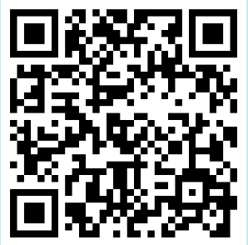
Inscrivez-vous à l’édition 2025 de la Journée Internationale

Slide 3
SHS CAM L3 - Marketing 6-week module
1. Introduction and evaluation details
2. Market Research; MyJobGlasses (+interview schedule), MillionRoads, LinkedIn
3. Creating your
brand with an eportfolio
4. Developing your brand through written communication Skills
5. Developing your brand through oral communication Skills
6. Review & upload
Marketing

Slide 4
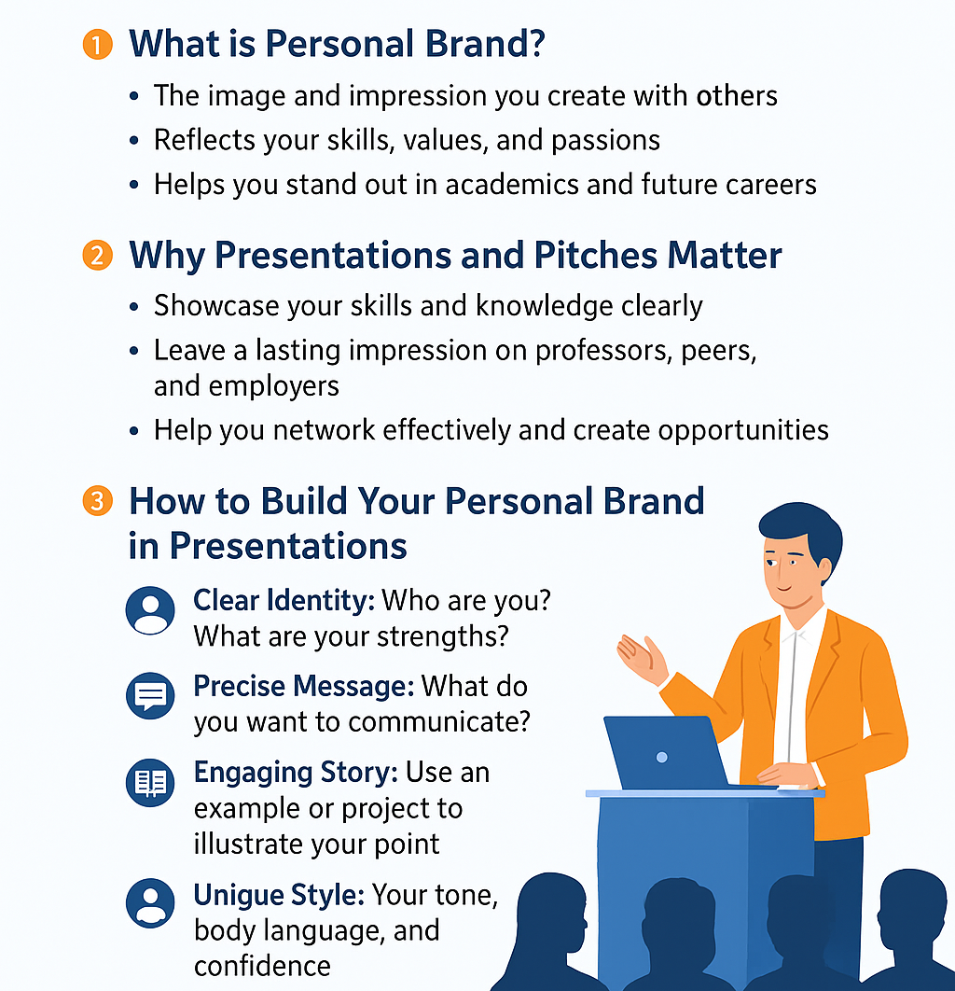
Develop your personal brand through presentations and pitching

Slide 5
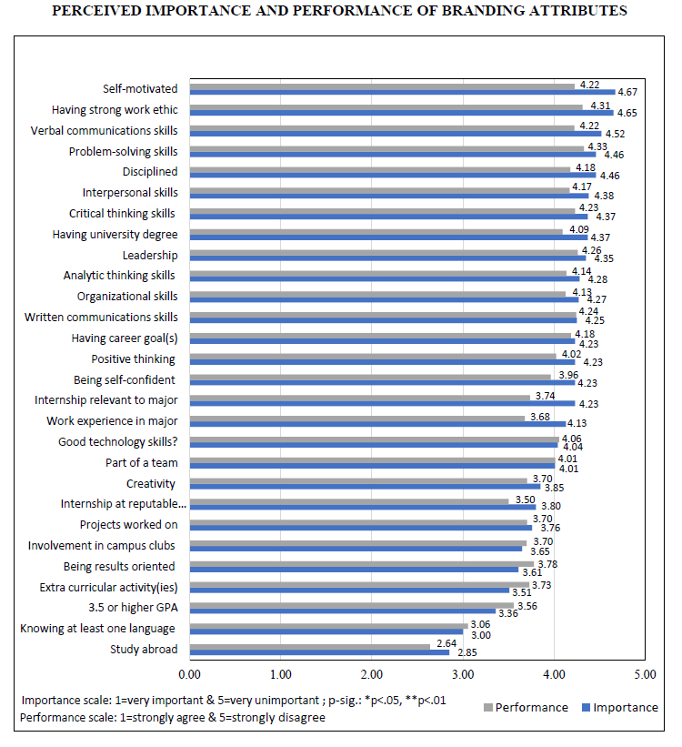

Scientific Insight: Understanding Student Perceptions of Their Personal Branding in Higher Education

Slide 6

CAM L3 – Module 1 – Marketing Evaluated deliverables to submit at the end of this module
Upload to Moodle at the end of this module (date to be confirmed) your ePortfolio or paper portfolio including a CAREER PROJECT section containing your
CVs in English & in French
LinkedIn* in English & in French (*highly recommended but optional)
Elevator pitch video – 2-3 minute high agency Unique Value Proposal in English with
a clear structure : present + (very brief) past + future
3 role model profiles analyzed (via LinkedIn, My Job Glasses, alumni interviews or other means)
3 potential international mobility projects aligned with your career objectives

Slide 7


Slide 8
Part 1 Prepare your pitch

Slide 9

You only have one chance to make a great first impression!
Why Your Pitch Is Important?
According to the U.S. Bureau of Labor Statistics, 70% of all jobs are found through networking. By engaging in networking activities, it allows you to raise awareness of “your personal brand” by meeting other professionals and sharing your ABILITIES, SKILLS and BACKGROUND. In turn when people in your network hear about potential opportunities, they can immediately think of you.
What Is An Elevator Pitch?
Short (30-60 second till 3 minutes) professional introduction about yourself
Great way to start a conversation with a potential employer
Can be used at networking events, career fairs, or informational interviews
Notes:
Before You Create Your Pitch, First Think About:
What makes you unique (from a professional skills perspective)?
What are you seeking?
What can you offer?
What do you want a person to remember about you?

Slide 10

Before You Create Your Pitch, First Think About:
What makes you unique (from a professional skills perspective)?
What are you seeking?
What can you offer?
What do you want a person to remember about you?

Slide 11
Example Elevator pitch
Hook: Start with an interesting fact or question.
Who You Are: Name, year, field of study.
What You Do / Your Idea: Highlight your skills, project, or passion.
Goal / Ask: State what you want – advice, connection, opportunity.
Closing: Finish confidently, inviting further conversation.
"Hi, I’m Alex, a first-year engineering student passionate about sustainable energy. I’m currently working on a solar-powered water pump prototype. I’d love to connect with professionals in renewable energy to learn from their experience."

Slide 12

Now You Try !
Turn to your neighbour and pitch yourself in 60 seconds max
What feedback can you give ?

Slide 13



Hone your « Tell me about yourself » video pitch to make a positive (likeability & competence) first impression
3 mins MAX not read from a script
enthusiastic, conversational flow, good quality English
remove background distractions (fridge, washing, people, noise, etc.)
check « smart casual » appearance, lighting, volume & camera angle
upgrade structure, reflection, arguments
NOW: Who are you? What are you currently studying?
PAST: Which experiences (academic and other) have lead you to N7?
FUTURE: What you would like to do in the near, mid & distant future? What are you plans A, B, C…? How will you reach your goal(s)?

Slide 14
A 3-Minute Version — What It Enables & Challenges – Best Practices Review
Segment | Approx Time Allocation | What You Can Include | What You Must Be Careful About
NOW | ~30 s | Who you are, what you study, your brand keywords, what excites you currently | Avoid over-detail, avoid getting lost in “backstory”
PAST | ~45 s | Key academic, professional or extracurricular experiences; lessons, transitions, values | Select only the strongest, relevant experiences; don’t overload with too many
FUTURE | ~2mins | Your near / mid / distant goals, plans A/B/C; pathway logic; how you plan to achieve them, the market research you have done – the three professionals you have spoken to and how they helped you decide to take this path, the three mobility options that could be useful for this path | Avoid overly speculative or vague goals; need to link to your “brand” and past experience

Slide 15
Part 2 Presentation Skills

Slide 16
Why do I need presentation skills?
Notes:
https://www.presentationtraininginstitute.com/presentation-skills-important-skill-set/

Slide 17

Why do I need presentation skills?
Good Presenters=Good Communicators
Presentation Skills Lead to Individual Success
Presentations are Important for Business Success
Presentation Skills are Important for Time Management
Presentation Skills Help You Connect with People
https://www.presentationtraininginstitute.com/presentation-skills-important-skill-set/
Notes:
https://www.presentationtraininginstitute.com/presentation-skills-important-skill-set/

Slide 18
Video Presentations
Viewers understand 95% of a message delivered through videos compared to 10% when they read them on text!!!!
Notes:
https://www.vmaker.com/blog/5-most-effective-tips-to-make-presentation-video-stand-out/

Slide 19
Tips for video presentations
Use quality audio equipment to record
Check the sound works before and after you post the video
Ensure there is no background noise
Ensure there is no background distractions
Fix the lighting (don’t have a glare on your glasses, don’t be sitting in the dark…)
Dress appropriately
Be precise and keep it short…

Slide 20
RAPID MOOC
• Service de captation vidéo de qualité professionnelle
• diaporama avec incrustation de soi (2024)
• diaporama avec réalité augmentée (à venir)
• Enregistrement clé en main
• 1 session de formation en novembre 2024 puis réservation d’un
créneau d’utilisation en autonomie (à la bibliothèque)
• Permet de s’entrainer à l’oral
• Travailler sa posture, son langage non verbal, son image
• Réduire le stress, ses tics de langage
biblion7@enseeiht.fr

Slide 21

The Four Ps of a successful presentation
Plan
Prepare
Practice
Present

Slide 22
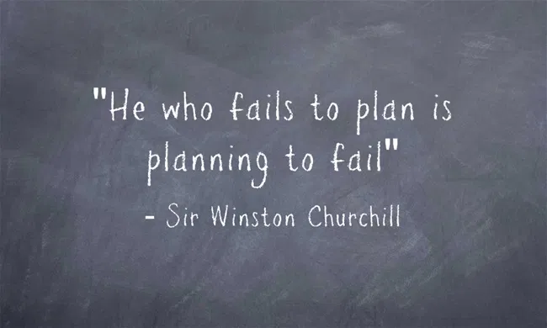
1. Plan
Ask yourself the following questions?
Who is my audience?
Why are they here?
What is my objective for this presentation?
How long should the presentation be?
Where will it take place?
What are any constraints I might have?

Slide 23

What do I need to plan for a video presentation??

Slide 24
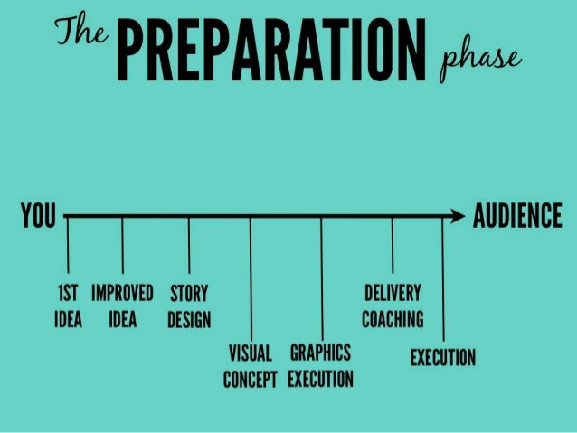
2. Prepare
Keep the following points in mind when you are preparing your presentation:
Structure
Style
Prompt
Visual aids
Voice
Appearance
Questions

Slide 25
Structure
Introduction
Grab the audience’s attention
Main theme
Audience relevant content
Summary
Key messages

Slide 26
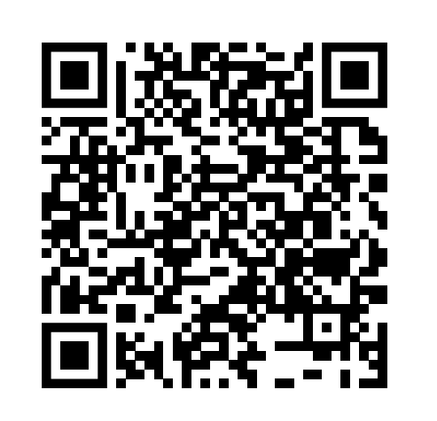
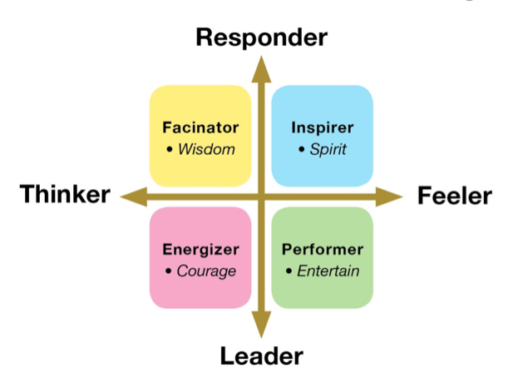
Style
Chose a presentation style that suits you (humour, visual affects, storytelling…)
Use words and sentences that you would use in everyday speech
Be yourself
https://ruletheroompublicspeaking.com/find-your-presentation-personality/
Notes:
https://ruletheroompublicspeaking.com/find-your-presentation-personality/
Fascinator = data
Inspirer = story teller
Performers = entertain
Energizer = motivate and stimulate

Slide 27

Prompts
Use short bullet points and KEY WORDS
Keep your prompts as your ppt slides
Prompts are for you
DO NOT READ DIRECTLY
FROM YOUR PHONE!!

Slide 28
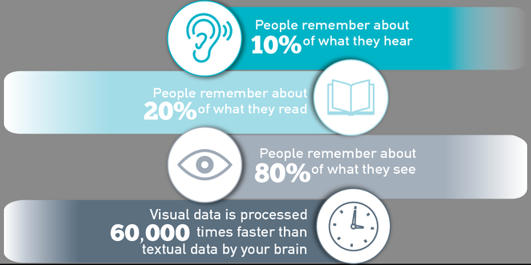
Visual aids
Use simple fonts, colours and graphs
Use images
3-7 bullets per slides
Don’t overcrowd your slides
Use a variety of visual aids

Slide 29

VOICE
Speak louder and more clear than in normal conversation
Vary your pitch and volume when highlighting certain points
Over emphasize

Slide 30

Appearance
Look professional
Ensure that you are comfortable in your clothes
Alow yourself to move – but not too much!
Look confident

Slide 31

Questions
Always anticipate the questions the audience may ask
Before the presentation starts, tell the audience if they can interrupt you for questions or should wait until the end
Prepare questions you might want to ask the audience as thinking points

Slide 32

Prepare
Take 10 mins
Prepare for your video pitch under the previously discussed headings:
Structure
Style
Prompts
Visual aids
Voice
Appearance

Slide 33

3. Practice
Rehearse all points that you have prepared
Practice again and again to manage time
Rehearse in front of a mirror or friend
Record yourself and watch back

Slide 34
4. Present
Make a strong start
Engage your audience within the first minute
Show your passion through your movements and gestures
Look directly at the camera
Don’t forget to smile ☺
https://engagevideomarketing.com/video/quick-tips/how-to-present-on-camera-6-practical-tips/

Slide 35
Hone your « Tell me about yourself » video pitch to make a positive (likeability & competence) first impression
3 mins MAX not read from a script
enthusiastic, conversational flow, good quality English
remove background distractions (fridge, washing, people, noise, etc.)
check « smart casual » appearance, lighting, volume & camera angle
upgrade structure, reflection, arguments
NOW: Who are you? What are you currently studying?
PAST: Which experiences (academic and other) have lead you to N7?
FUTURE: What you would like to do in the near, mid & distant future? What are you plans A, B, C…? How will you reach your goal(s)?

Slide 36
Over to you
In groups of two, present and critique your pitches.

Slide 37
Body Language
Eye contact establishes an immediate bond with an audience, especially when a speaker focuses in on individual listeners rather than just gazing over the audience as a whole.
Control mannerisms. Mannerisms are the nervous expressions a speaker might not be aware of such as putting their hands in their pockets, nodding their head excessively, or using filler words like um and ah too often.
Put verbs in to action when speaking to an audience by physically acting them out with the hands, face or entire body.
Avoid insincere gestures by involving the entire body as much as possible in the movement and matching facial expressions to it.

Slide 38
Last minute tips
Be prepared. Your audience is giving you their time and consideration, so rehearse enough to be confident you'll leave a good impression.
Start strong. Begin your speech with a powerful opening that will grab your audience's attention, such as a startling fact or statistic, an interesting story or a funny joke.
Be conversational. Avoid reading your speech word for word. Instead, refer to notes or points from an outline to help your speech have a more free-flowing, conversational tone.
Speak with passion. If you're truly invested in what you're saying, you'll be better able to keep your audience's attention.
Be patient. It's easy to get frustrated if you make a mistake. But remember that public speaking is not easy and it takes time to hone your skills. Keep practicing and you will reach your goals.

Slide 39
Part Update your eportfolio

Slide 40


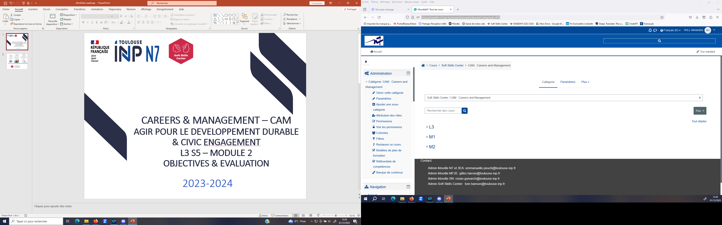
Showcasing,
external consultation, recommendations, selection
Validations
to obtain
engineering diploma
Creativity,
self-awareness & self-management
PEP jury
Alumni & staff
Department directors
Recommendation authors
Option deciders
Civic engagement 40 hours S9 or S10
Mobility 9 weeks S9 (17 for FISE)
Internships S6 & S8
English level B2+ S9
Other
Branding, UVP
E-reputation
Digital Self-marketing
S5
S6
S7
S8
S9
S10
Launch Upgrade Validation
E-portfolios at ENSEEIHT

Slide 41
2. Add your main tabs
6 tabs minimum to be completed over 3 years of studies to showcase skills, projects & best productions:
Welcome
Engineering course
International Mobility
Sustainability & Civic Engagement
Sport & other activities
Career Development

Slide 42
Personalise your e-portfolio
Add your picture
Add an introductory note about yourself
Add your projects you are currently working on
Add a link to your linkedIn
Add your CV
Add your interests and hobbies

Slide 43
Review your e-portfolio
Send the link for your e-portfolio to the person sitting beside you
Check that the link works
What is your first impression of their e-portfolio?
What would you change?

Slide 44
Bibliography
[1] U.S. Bureau of Labor Statistics, “How to network to find a job,” 2023. [Online]. Available: https://www.bls.gov.
[2] T. Girard, M. Pinar, and L. Lysiak, “Understanding student perceptions of their personal branding in higher education,” Journal of Marketing for Higher Education, 2021.
[3] S. Sampath and P. Bawa, “The impact of personal branding on career success,” International Journal of Research in Management & Business Studies, vol. 6, no. 3, 2019.
[4] C. Smith and A. Smith, “Educating students to create and manage their personal brand,” International Journal of Education and Social Science Research, vol. 5, no. 10, pp. 23–34, 2022
[5] University of Pennsylvania Graduate Student Center, “Time to perfect your elevator pitch,” 2023. [Online]. Available: https://gsc.upenn.edu/time-perfect-your-elevator-pitch
[6] Princeton University, Center for Career Development, “Developing your elevator pitch,” 2024. [Online]. Available: https://careerdevelopment.princeton.edu/guides/networking/developing-your-elevator-pitch
[7] Presentation Training Institute, “Why presentation skills are important,” 2024. [Online]. Available: https://www.presentationtraininginstitute.com/presentation-skills-important-skill-set/
[8] NTD Training Videos, “How to look good in Skype interviews – Tips & Training,” YouTube, 2023.

